Slide 1

Title
Stephen McLaughlin
PhD Student

Slide 2
Stephen McLaughlin / @SteveMcLaugh
Notes:
This is not an option.

Slide 3
Stephen McLaughlin / @SteveMcLaugh
Notes:
http://gtspirit.com/2014/03/12/renault-caterham-sports-car-design-as-good-as-finished/

Slide 4
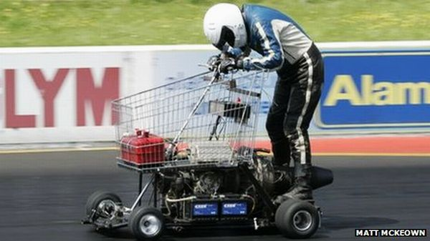
Stephen McLaughlin / @SteveMcLaugh
Notes:
https://www.youtube.com/watch?v=xz8_udPVdok
Fast, but not the easiest thing to handle — and it might be a bumpy ride

Slide 5
Stephen McLaughlin / @SteveMcLaugh
Notes:
This is not an option.

Slide 6
Title
1
2
3
4
Stephen McLaughlin / @SteveMcLaugh

Slide 7
Title
1
2
3
4
Stephen McLaughlin / @SteveMcLaugh

Slide 8
General metadata goals
Segmentation by speaker
Stephen McLaughlin / @SteveMcLaugh
Notes:
#metadatagoals

Slide 9
General metadata goals
Segmentation by speaker
Segmentation by event structure
Stephen McLaughlin / @SteveMcLaugh
Notes:
#metadatagoals

Slide 10
General metadata goals
Segmentation by speaker
Segmentation by event structure
High-level labels
Language
Genre
Topic/theme
Stephen McLaughlin / @SteveMcLaugh
Notes:
#metadatagoals

Slide 11
General metadata goals
Segmentation by speaker
Segmentation by event structure
High-level labels
Language
Genre
Topic/theme
Low-level labels
Notable passages
Material features/quirks
Stephen McLaughlin / @SteveMcLaugh
Notes:
#metadatagoals

Slide 12
General search goals
Acoustic fingerprint search (à la Shazam)
Stephen McLaughlin / @SteveMcLaugh
Notes:
The means to creating useful metadata as in the previous slide

Slide 13
General search goals
Acoustic fingerprint search (à la Shazam)
Locate speaker of interest
Stephen McLaughlin / @SteveMcLaugh
Notes:
The means to creating useful metadata as in the previous slide

Slide 14
General search goals
Acoustic fingerprint search (à la Shazam)
Locate speaker of interest
Locate sound classes of interest
Stephen McLaughlin / @SteveMcLaugh
Notes:
The means to creating useful metadata as in the previous slide

Slide 15
General search goals
Acoustic fingerprint search (à la Shazam)
Locate speaker of interest
Locate sound classes of interest
Full-text search
Stephen McLaughlin / @SteveMcLaugh
Notes:
The means to creating useful metadata as in the previous slide

Slide 16
Concrete PennSound goals
Expedite laborious segmentation work
Stephen McLaughlin / @SteveMcLaugh
Notes:
radio: eg, interviewed about another poet
Locate poems of interest – for non-segmented works

Slide 17
Concrete PennSound goals
Expedite laborious segmentation work
Assemble centralized metadata set
Stephen McLaughlin / @SteveMcLaugh
Notes:
radio: eg, interviewed about another poet
Locate poems of interest – for non-segmented works

Slide 18
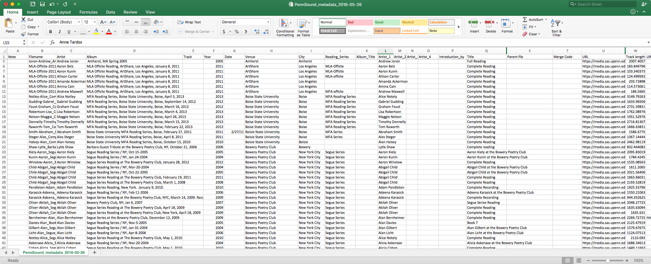
Stephen McLaughlin / @SteveMcLaugh

Slide 19
Concrete PennSound goals
Expedite laborious segmentation work
Assemble centralized metadata set
Locate poems of interest
Stephen McLaughlin / @SteveMcLaugh
Notes:
radio: eg, interviewed about another poet
Locate poems of interest – for non-segmented works

Slide 20
Concrete PennSound goals
Expedite laborious segmentation work
Assemble centralized metadata set
Locate poems of interest
Locate speakers of interest where metadata is scant
Q&A sessions
Panel discussions
Recorded seminars
Radio/TV/film appearances
Stephen McLaughlin / @SteveMcLaugh
Notes:
radio: eg, interviewed about another poet
Locate poems of interest – for non-segmented works

Slide 21
Approaches at hand
Event detection (silence, applause, etc.)
Speech to text
Unsupervised speaker diarization
Speaker recognition
Closed set: classification among pre-enrolled speakers
Open set: searching for given speaker(s) against universal background model (UBM)
Stephen McLaughlin / @SteveMcLaugh
Notes:
Crude event detection
open set = haystack search
Trained using universal background model (UBM)

Slide 22
Changes in the past 5 years
Processors are faster.
Storage is cheaper.
VPSes are friendlier.
More and better core ML tools.
More and better high-level wrappers.
GitHub and Stack Exchange are much larger.
Stephen McLaughlin / @SteveMcLaugh
Notes:
And I’m gonna be ... permit me to deal in straw men for a sec. This isn’t even polemical, it’s just a matter of fact.

Slide 23
Stack Goals
Free / open source software
Cost, scale, customization, transparency, stability, pedagogy, ideology
Stephen McLaughlin / @SteveMcLaugh
Notes:
Pedagogy: Students learn at home. And it’s harder than ever to find illicit copies of commercial software
Openness is political
ideology=political ideals and...
Last but not least: smug sense of superiority

Slide 24
Stack Goals
Free / open source software
Cost, scale, customization, transparency, stability, pedagogy, ideology
Avoid weird exchange formats. Aim for human and machine readability.
CSV > JSON > XML > DBs > Proprietary BLOBs
Stephen McLaughlin / @SteveMcLaugh
Notes:
Human(ist) readable
If you don’t need a tree, don’t use a tree
When you get really big, you do need databases. That’s no joke. But even in those cases, back everything up in flat files.

Slide 25
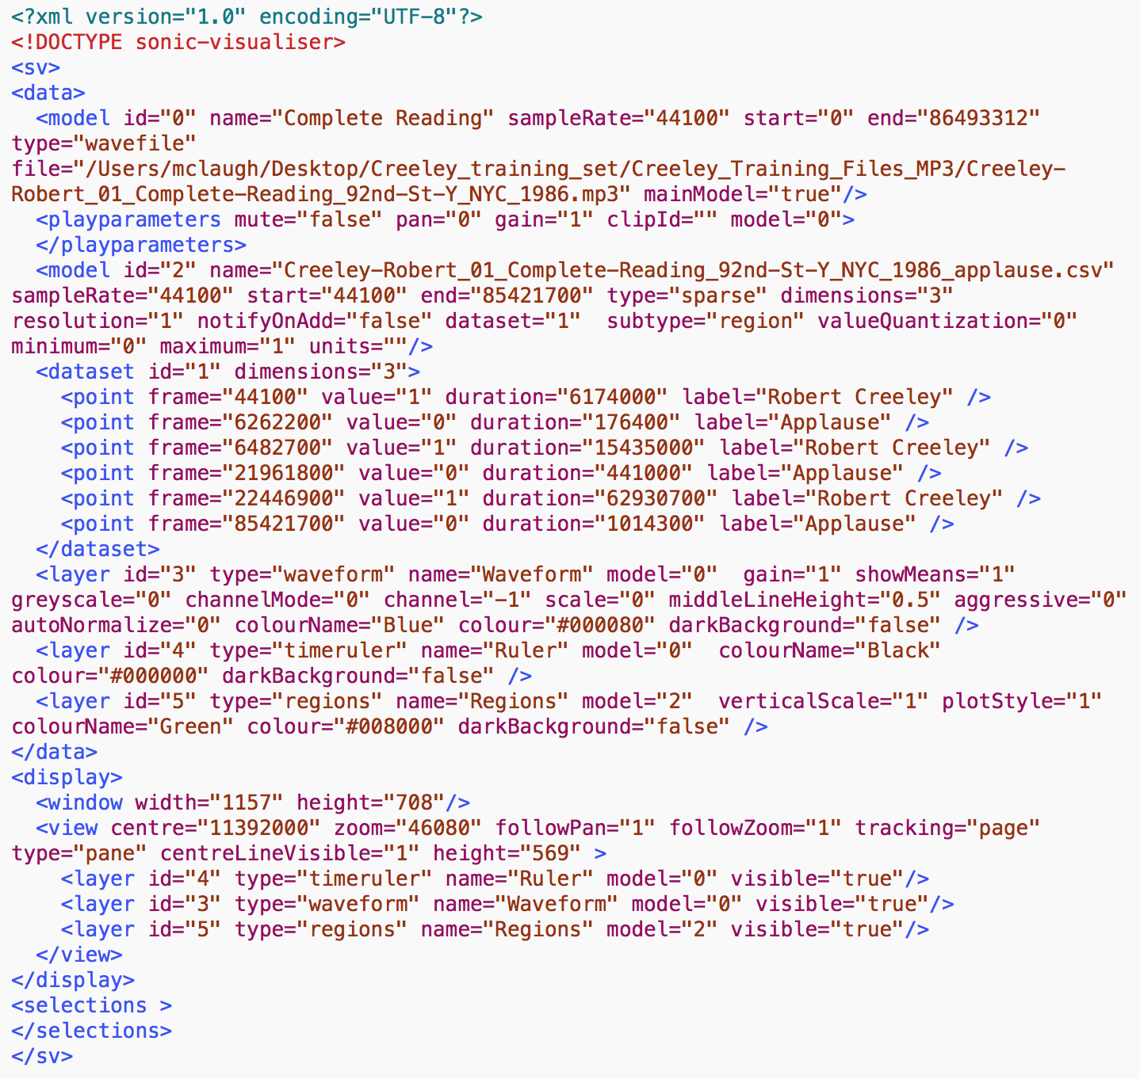
Sonic Visualiser
session file
Stephen McLaughlin / @SteveMcLaugh
Notes:
In the grand scheme, this is really refreshing. This is the whole session file — it has a hardcoded reference to the file’s pathname, totally transparent. But I take issue with the “frame” field ...
The sample rate is there, so one could check the timing later — but my real aim is to make this stuff friendly for humanists, who tend to be bad programmers — like me, by the way. I’m a bad programmer. I’m trying, but ... I’ll never be on the level of someone like Tony.
A lot of core GNU utilities have a –h option for human readability.
Be the -h you want to see in the world
PyDub handles this commendably: uses milliseconds regardless of sample rate

Slide 26
142.000000000,0,4.000000000,Applause
498.000000000,0,10.000000000,Applause
512.024761904,1,1406.000000000,Robert Creeley
1937.000000000,0,23.000000000,Applause
Sonic Visualiser
CSV file
Stephen McLaughlin / @SteveMcLaugh
Notes:
In the grand scheme, this is really refreshing. This is the whole session file — it has a hardcoded reference to the file’s pathname, totally transparent. But I take issue with the “frame” field ...
The sample rate is there, so one could check the timing later — but my real aim is to make this stuff friendly for humanists, who tend to be bad programmers — like me, by the way. I’m a bad programmer. I’m trying, but ... I’ll never be on the level of someone like Tony.
A lot of core GNU utilities have a –h option for human readability.
Be the -h you want to see in the world
PyDub handles this commendably: uses milliseconds regardless of sample rate

Slide 27
Stack Goals
Free / open source software
Cost, scale, customization, transparency, stability, pedagogy, ideology
Avoid weird exchange formats. Aim for human and machine readability.
CSV > JSON > XML > DBs > Proprietary BLOBs
Media format flexibility
WAV, MP3, etc.
Stephen McLaughlin / @SteveMcLaugh
Notes:
Human(ist) readable
If you don’t need a tree, don’t use a tree
When you get really big, you do need databases. That’s no joke. But even in those cases, back everything up in flat files.

Slide 28
Stack Goals
Free / open source software
Cost, scale, customization, transparency, stability, pedagogy, ideology
Avoid weird exchange formats. Aim for human and machine readability.
CSV > JSON > XML > DBs > Proprietary BLOBs
Media format flexibility
WAV, MP3, etc.
Python & bash interfaces where possible
Stephen McLaughlin / @SteveMcLaugh
Notes:
Human(ist) readable
If you don’t need a tree, don’t use a tree
When you get really big, you do need databases. That’s no joke. But even in those cases, back everything up in flat files.

Slide 29
Programmers are lazy.
Stephen McLaughlin / @SteveMcLaugh
Notes:
And that is their value proposition, so to speak.

Slide 30
#teamgoals
Technical collaborators with perfectly aligned research interests
Supercomputer access
Funding for worker bees
Expertise in signal processing & machine learning
Stephen McLaughlin / @SteveMcLaugh

Slide 31
Stephen McLaughlin / @SteveMcLaugh
Notes:
This is not an option.

Slide 32
Title
1
2
3
4
Stephen McLaughlin / @SteveMcLaugh

Slide 33
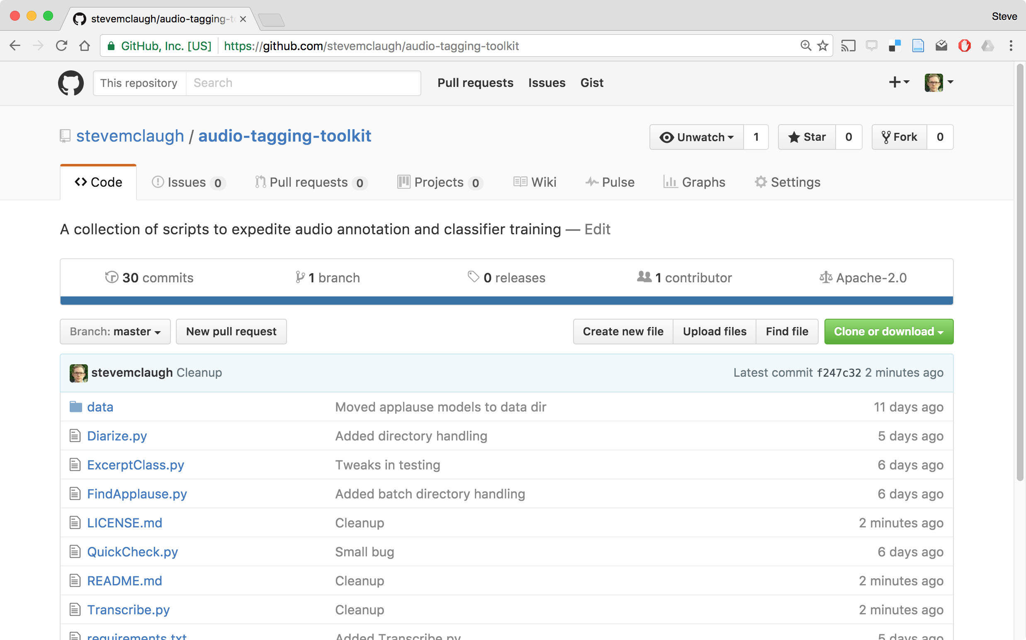
Stephen McLaughlin / @SteveMcLaugh
Notes:
REPLACE

Slide 34




PocketSphinx
Pyperclip
Stephen McLaughlin / @SteveMcLaugh

Slide 35
pyAudioAnalysis
Created and maintained by Theodoros Giannakopoulos
Built on scikit-learn and the SciPy stack
Executes training, classification, silence removal, etc.
Handles dimension reduction and hyperparameter tuning
Simple interface, comprehensible code from pyAudioAnalysis import audioTrainTest as aT aT.featureAndTrain(['Background','Creeley'], 1.0, 1.0, aT.shortTermWindow, aT.shortTermStep, "svm", "svm_creeley", False)
Stephen McLaughlin / @SteveMcLaugh
Notes:
*
If I was bitter or disillusioned about poetry culture, it was perhaps because I hadn’t found my own community.
But eventually I did.
In the years following Issue 1 I got involved in practice.
I submitted videos to Ubuweb.
I did archival work for PennSound and edited the podcast PoemTalk at the Writers House.
I hosted my own poetry interview podcast on Jacket2.org
And I hosted a reading series in Philadelphia from 2011 to 2014, called Principal Hand Presents.
The scene I was a part of — conceptual, post-conceptual — was essentially a complete gift economy.
Giving chapbooks away, sharing PDFs, swapping ideas and links on email threads.
- That became central to my understanding of what it was to write, to make things. Not an alternative to mass culture, but a parallel track where we had some autonomy.

Slide 36
Audio Tagging Toolkit
Find applause in single recording python FindApplause.py -c -b -l "Speaker Name" -i /path/to/audio.mp3
Batch applause classification python FindApplause.py -c -b -l "Speaker Name" path/to/directory/
Batch diarize python Diarize.py -c -b path/to/directory/
Stephen McLaughlin / @SteveMcLaugh
Notes:
*
If I was bitter or disillusioned about poetry culture, it was perhaps because I hadn’t found my own community.
But eventually I did.
In the years following Issue 1 I got involved in practice.
I submitted videos to Ubuweb.
I did archival work for PennSound and edited the podcast PoemTalk at the Writers House.
I hosted my own poetry interview podcast on Jacket2.org
And I hosted a reading series in Philadelphia from 2011 to 2014, called Principal Hand Presents.
The scene I was a part of — conceptual, post-conceptual — was essentially a complete gift economy.
Giving chapbooks away, sharing PDFs, swapping ideas and links on email threads.
- That became central to my understanding of what it was to write, to make things. Not an alternative to mass culture, but a parallel track where we had some autonomy.

Slide 37
Audio Tagging Toolkit
Find applause in single recording python FindApplause.py -c -b -l "Speaker Name" -i /path/to/audio.mp3
Batch applause classification python FindApplause.py -c -b -l "Speaker Name" path/to/directory/
Batch diarize python Diarize.py -c -b path/to/directory/
Stephen McLaughlin / @SteveMcLaugh
Notes:
*
If I was bitter or disillusioned about poetry culture, it was perhaps because I hadn’t found my own community.
But eventually I did.
In the years following Issue 1 I got involved in practice.
I submitted videos to Ubuweb.
I did archival work for PennSound and edited the podcast PoemTalk at the Writers House.
I hosted my own poetry interview podcast on Jacket2.org
And I hosted a reading series in Philadelphia from 2011 to 2014, called Principal Hand Presents.
The scene I was a part of — conceptual, post-conceptual — was essentially a complete gift economy.
Giving chapbooks away, sharing PDFs, swapping ideas and links on email threads.
- That became central to my understanding of what it was to write, to make things. Not an alternative to mass culture, but a parallel track where we had some autonomy.

Slide 38
Audio Tagging Toolkit
Find applause in single recording python FindApplause.py -c -b -l "Speaker Name" -i /path/to/audio.mp3
Batch applause classification python FindApplause.py -c -b -l "Speaker Name" path/to/directory/
Batch diarize python Diarize.py -c -b path/to/directory/
Stephen McLaughlin / @SteveMcLaugh
Notes:
*
If I was bitter or disillusioned about poetry culture, it was perhaps because I hadn’t found my own community.
But eventually I did.
In the years following Issue 1 I got involved in practice.
I submitted videos to Ubuweb.
I did archival work for PennSound and edited the podcast PoemTalk at the Writers House.
I hosted my own poetry interview podcast on Jacket2.org
And I hosted a reading series in Philadelphia from 2011 to 2014, called Principal Hand Presents.
The scene I was a part of — conceptual, post-conceptual — was essentially a complete gift economy.
Giving chapbooks away, sharing PDFs, swapping ideas and links on email threads.
- That became central to my understanding of what it was to write, to make things. Not an alternative to mass culture, but a parallel track where we had some autonomy.

Slide 39
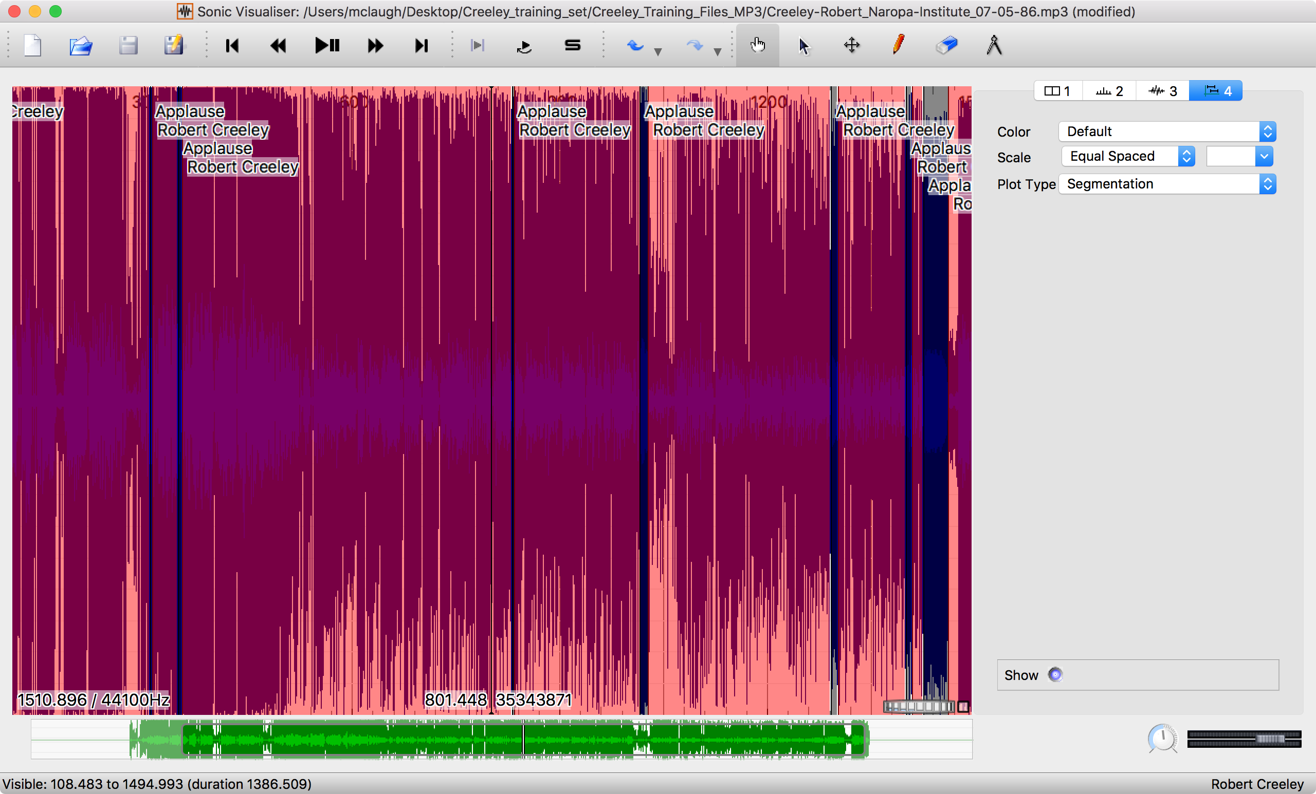
Stephen McLaughlin / @SteveMcLaugh
Notes:
Developed at the Centre for Digital Music, Queen Mary, University of London.
Alternatives: PRAAT, ANVIL, Transcriber

Slide 40
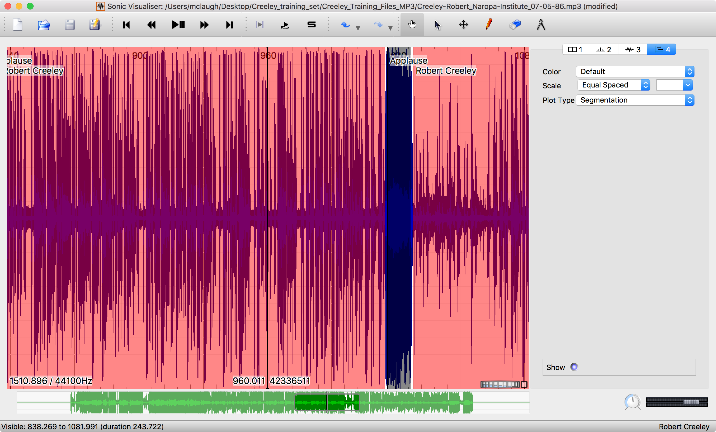
Stephen McLaughlin / @SteveMcLaugh

Slide 41
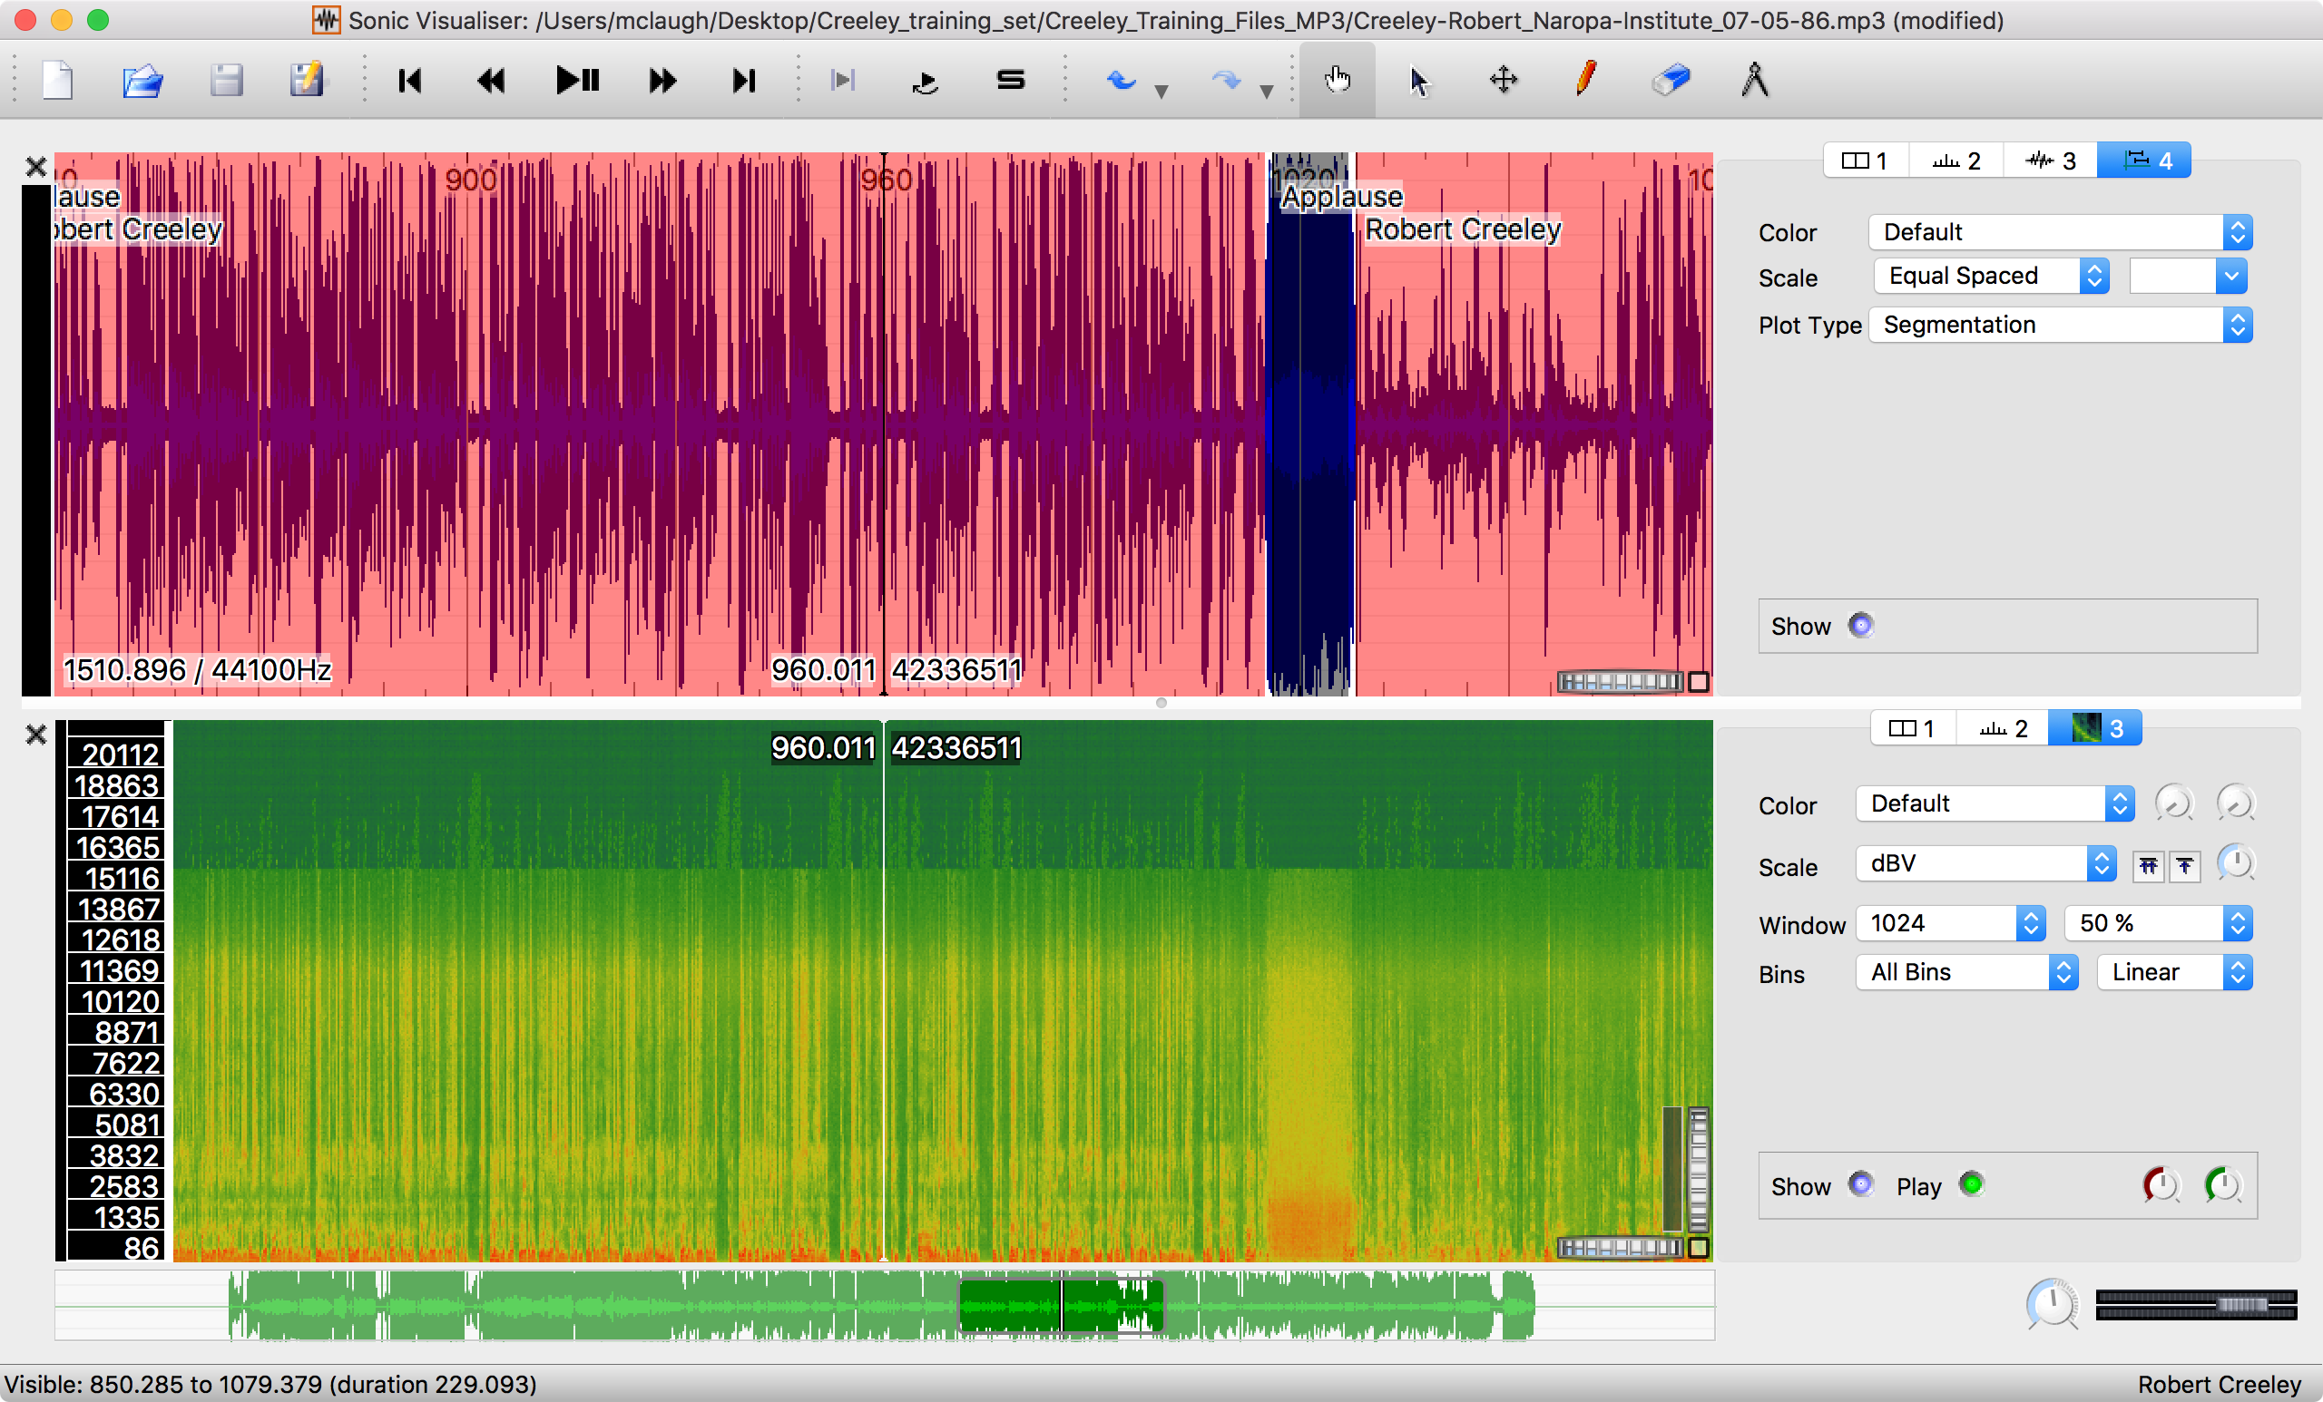
Stephen McLaughlin / @SteveMcLaugh
Notes:
Creeley: 340 files
140 corrected by hand to get 15 hours
10 hours of PennSound UBM

Slide 42
Stephen McLaughlin / @SteveMcLaugh
Notes:
Creeley-Robert_01_Complete-Reading_92nd-St-Y_NYC_1986.mp3 demo –
2 applauses at beginning separate intro and reading(?) by someone else - example of quickly finding transition that would otherwise be time-consuming to locate
Intro by Shelley(sp) Mason, director of the poetry center
Gwendolyn Brooks & Creeley, both introduced by DH Mellom

Slide 43
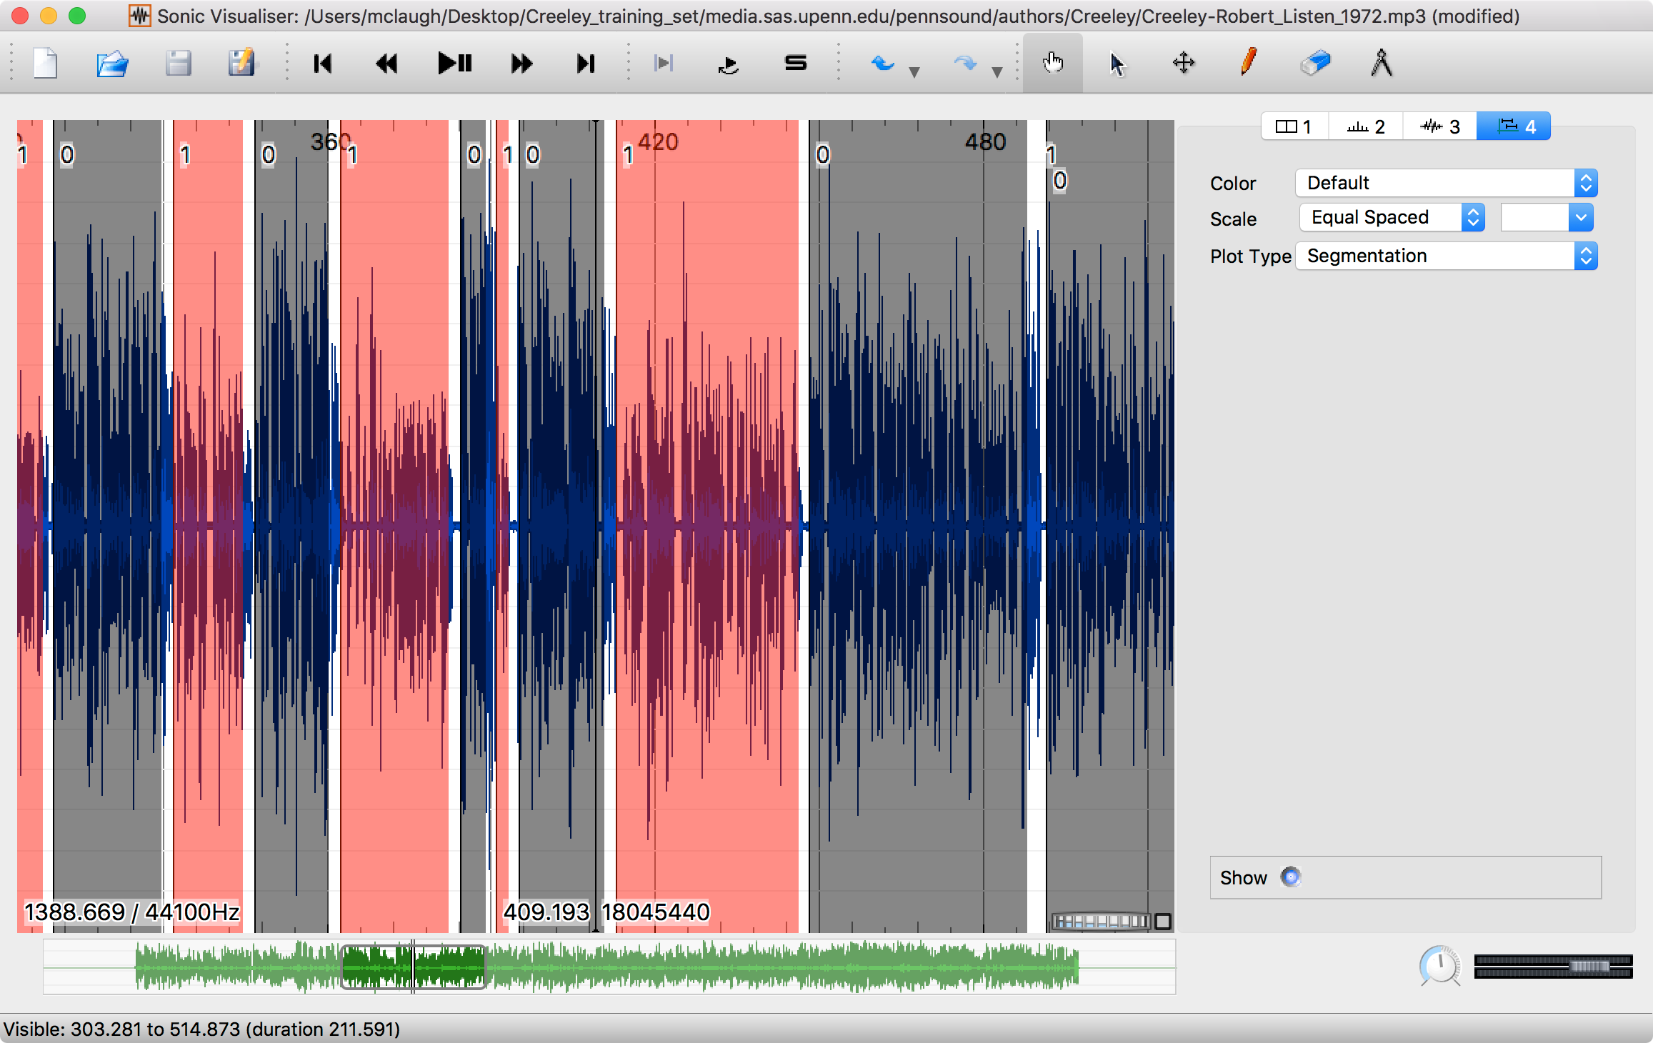
Stephen McLaughlin / @SteveMcLaugh

Slide 44
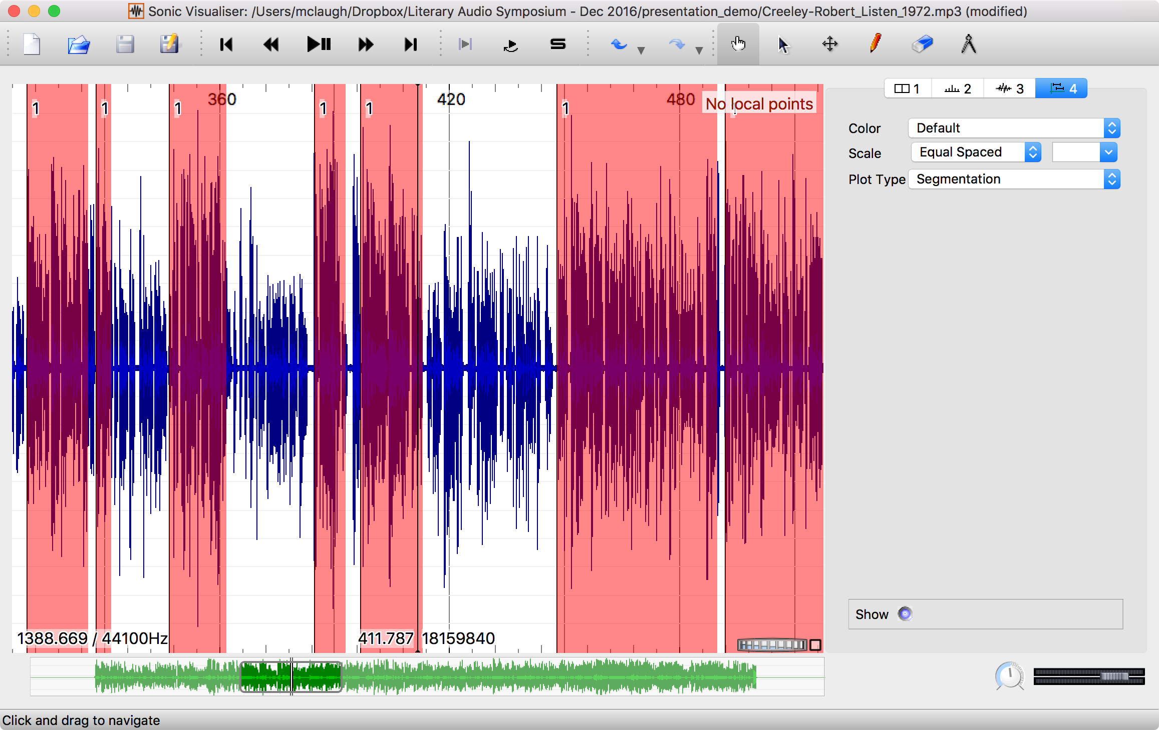
Stephen McLaughlin / @SteveMcLaugh

Slide 45

⟶
applause detection and/or diarization
⟶
manual validation
⟶
speaker recognition
⟶
manual validation
⟶
annotated corpus
⟶
retrieval, segmentation, new ML training, etc.
Stephen McLaughlin / @SteveMcLaugh
Notes:
*
If I was bitter or disillusioned about poetry culture, it was perhaps because I hadn’t found my own community.
But eventually I did.
In the years following Issue 1 I got involved in practice.
I submitted videos to Ubuweb.
I did archival work for PennSound and edited the podcast PoemTalk at the Writers House.
I hosted my own poetry interview podcast on Jacket2.org
And I hosted a reading series in Philadelphia from 2011 to 2014, called Principal Hand Presents.
The scene I was a part of — conceptual, post-conceptual — was essentially a complete gift economy.
Giving chapbooks away, sharing PDFs, swapping ideas and links on email threads.
- That became central to my understanding of what it was to write, to make things. Not an alternative to mass culture, but a parallel track where we had some autonomy.

Slide 46
Stephen McLaughlin / @SteveMcLaugh
Notes:
REPLACE

Slide 47
Stephen McLaughlin / @SteveMcLaugh
Notes:
This is not an option.

Slide 48
Bottlenecks to wide application
Compute time
Stephen McLaughlin / @SteveMcLaugh

Slide 49
Bottlenecks to wide application
Compute time
Existing metadata quality
Stephen McLaughlin / @SteveMcLaugh

Slide 50
Bottlenecks to wide application
Compute time
Existing metadata quality
Human ML training time
Stephen McLaughlin / @SteveMcLaugh

Slide 51
Bottlenecks to wide application
Compute time
Existing metadata quality
Human ML training time
Technical literacy
Stephen McLaughlin / @SteveMcLaugh

Slide 52
Bottlenecks to wide application
Compute time
Existing metadata quality
Human ML training time
Technical literacy
Copyright restrictions
Stephen McLaughlin / @SteveMcLaugh

Slide 53
Humanists are patient.
Stephen McLaughlin / @SteveMcLaugh
Notes:
Digging through archives is hard, and it’s maddening — and it’s fun! But it can also be brutally boring, and that’s the work that humanists do: literary studies, material history, regular history ... it’s a slog.
I’m kinda glad I only have one foot in literary studies,.
Keep being patient, people.

Slide 54
Meaningful search ⟶ Long-term preservation
Stephen McLaughlin / @SteveMcLaugh
Notes:
If this isn’t out of school — PennSound has things they don’t post for the public ... but in principle they *could* make that material searchable in some form.
I’d love if one of you want to push this far enough to get sued ... though the supreme court does change from time to time

Slide 55
Title
1
2
3
4
Stephen McLaughlin / @SteveMcLaugh

Slide 56
Stephen McLaughlin / @SteveMcLaugh
Notes:
This is not an option.

Slide 57
Title
1
2
3
4
Stephen McLaughlin / @SteveMcLaugh

Slide 58
Stephen McLaughlin / @SteveMcLaugh
Notes:
This is not an option.

Slide 59
Title
1
2
3
4
Stephen McLaughlin / @SteveMcLaugh

Slide 60
Stephen McLaughlin / @SteveMcLaugh
Notes:
This is not an option.

Slide 61
Title
1
2
3
4
Stephen McLaughlin / @SteveMcLaugh

Slide 62
Stephen McLaughlin / @SteveMcLaugh
Notes:
This is not an option.

Slide 63
Title
1
2
3
4
Stephen McLaughlin / @SteveMcLaugh

Slide 64
Stephen McLaughlin / @SteveMcLaugh
Notes:
This is not an option.

Slide 65
Title
1
2
3
4
Stephen McLaughlin / @SteveMcLaugh

Slide 66
Stephen McLaughlin / @SteveMcLaugh
Notes:
This is not an option.

Slide 67
Title
1
2
3
4
Stephen McLaughlin / @SteveMcLaugh

Slide 68
Stephen McLaughlin / @SteveMcLaugh
Notes:
This is not an option.

Slide 69
Title
1
2
3
4
Stephen McLaughlin / @SteveMcLaugh

Slide 70
Stephen McLaughlin / @SteveMcLaugh
Notes:
This is not an option.

Slide 71
Title
1
2
3
4
Stephen McLaughlin / @SteveMcLaugh

Slide 72
Stephen McLaughlin / @SteveMcLaugh
Notes:
This is not an option.

Slide 73
Title
1
2
3
4
Stephen McLaughlin / @SteveMcLaugh

Slide 74
Stephen McLaughlin / @SteveMcLaugh
Notes:
This is not an option.

Slide 75
Title
1
2
3
4
Stephen McLaughlin / @SteveMcLaugh

Slide 76
Stephen McLaughlin / @SteveMcLaugh
Notes:
This is not an option.

Slide 77
Title
1
2
3
4
Stephen McLaughlin / @SteveMcLaugh

Slide 78
Stephen McLaughlin / @SteveMcLaugh
Notes:
This is not an option.

Slide 79
Title
1
2
3
4
Stephen McLaughlin / @SteveMcLaugh

Slide 80
Stephen McLaughlin / @SteveMcLaugh
Notes:
This is not an option.

Slide 81
Title
1
2
3
4
Stephen McLaughlin / @SteveMcLaugh

Slide 82
Stephen McLaughlin / @SteveMcLaugh
Notes:
This is not an option.

Slide 83
Title
1
2
3
4
Stephen McLaughlin / @SteveMcLaugh

